Slide 1
Criminal Defense in Bexar County or
I want trial experience.
Or
I’m having a hard time finding a position and need to make money while I search for a job.
Or
What happens when my cousin picks up a misdemeanor and I have to handle it pro bono
Or
I had a REALLY important text message officer! Please don’t…

Slide 2
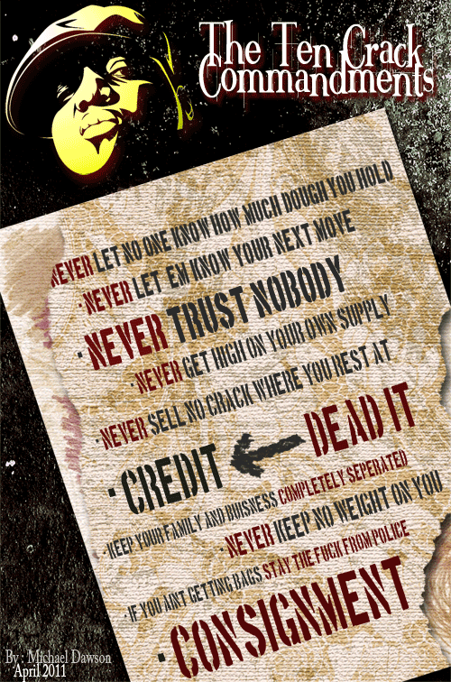

Slide 3
Topics I want to cover
Bexar County Misdemeanor Court
  Misdemeanor wheel
  Useful Terms
  Maps, Apps, and “Oh Crap”’s
    How to get around the courthouse
    Useful tricks, hints, and websites
    Ways to get disbarred ☺
Traffic Tickets
Operation
  How not to get “Buzzed” on the Difference between DWI and SA Muni Code (Use of a Hand Held Device)

Slide 4
Topics I can’t cover
Felonies
  “Strictly for live men, not for freshmen”
DWI
  Extremely detailed and technical
  Ask me again tonight at the Xmas party.
Fact-Specific Question
  So I got this friend…
Contracts, IOLTAs, running a business
Case Law, etc

Slide 5
Quick Hints
Please feel free to ask questions!
Get a reliable Calendar (Gmail, Outlook)
Find a friend in law school to use Lexis/Westlaw password
Fax Machine
  Use an online faxing service (Ringcentral)
Get Office Space
  “Never sell no crack where you rest at. I don’t care if they want an Ounce, tell them BOUNCE”
  State Bar and Appointment order lists your address and Phone number
Get a Work Phone
  (unless you want a criminal blowing up your phone at 3am to discuss your case)
TYLA – Office in a Flash
  http://www.tyla.org/tyla/assets/Flash/officeinaflash.html

Slide 6
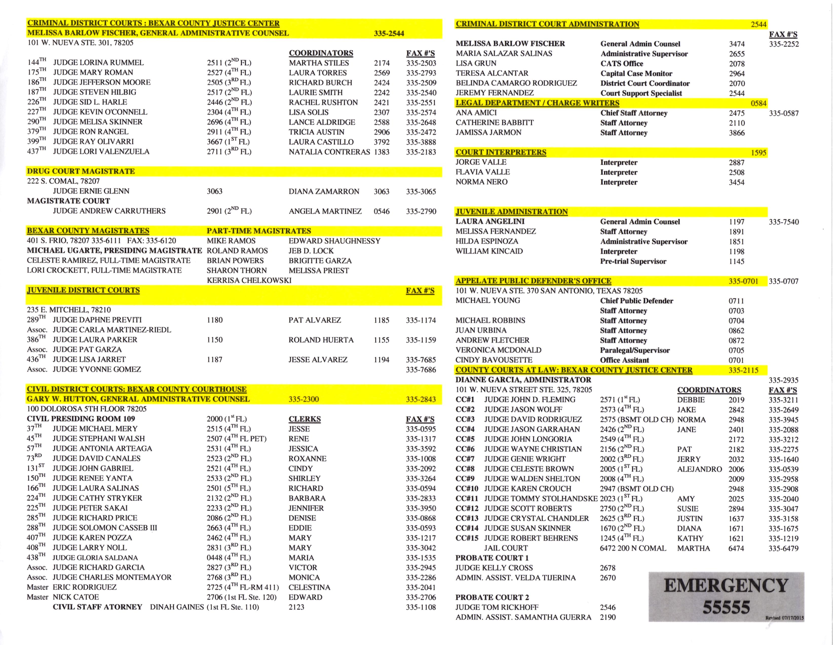

Slide 7
Find Your Courtroom
Bexar County Justice Center
1st Floor
2nd Fl
3rd Fl
4th floor
CC1 (Fleming)
14 (Susan Skinner)
Family Violence
CC 5 (Longoria)
CC2 (Wolff)
CC15 (Behrens)
CC 9 (Shelton)
CC 8 (Brown)
CC 11 - Stolhanske
12 (Roberts)
4 (Garrahan)
6 (Christian)
7 (Wright)
13 (Chandler)

Slide 8
Who is in my Courtroom?
The one with the gun (Deputy)
The one that keeps you from appearing on the record as dumb as you sound (Court Reporter)
The one wearing the black dress (Judge)
The two (or 3) probably in a suit (Prosecutors)
CLO
  Community Liaison Officer (Probation Representative)
Court Coordinator
  The Boss.
Clerk – two in the Court offices in the back to input things in the system

Slide 9
Court Coordinator
Handles the Court calendar
  Reset your case
  May assign you to a case “In The Interests of Justice”
  Or remove you from an appointed case “In The Interests of justice”
    The person to call if you’re running late
Tracks and Manages jail population
  Assigns your case to jail court
Alerts judge to other issues (bond, warrant, etc)
Tracks cases on Appeal (remand)

Slide 10
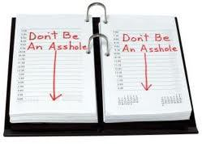
Rule #1

Slide 11

RULE 11 Agreements?
No Rule 11 agreements in Criminal Courts - Word is Bond
Don’t take things personally

Slide 12
What’s the Wheel?
In Bexar County, indigent defense is handled by private attorneys. Cases are assigned to attorneys “randomly” through a process called “The Wheel”.

Slide 13
Wheel Appointment
Upon selection by the computer, the attorney will receive instantaneous notification by both email and fax.
  That notification will include the name, address/location, phone number of the defendant as well as the SID, Case Number, charge, Court and arraignment date if applicable.
  The defendant will receive a print out with the name, address and phone number of the appointed attorney.
MUST CONTACT YOUR CLIENT in 48 HOURS!!
  Send a letter to client or RAV visit

Slide 14
Practice Tip
As an alternative, the Judge can make the attorney appointment in court under ‘interest of justice’ criteria. If the appointment is made by the Judge in the interest of justice, the rationale for the appointment must be placed on the record
Coordinators have almost full discretion on this.
  Practice Tip – be nice to the Court Coordinator.
  “Rule nombre uno, never let no one know how much dough you hold, cause you know… cheddar breed jealousy…”

Slide 15
If Hired on a Case
Get your money up front
  “… credit? Dead it. Think a crackhead payin’ you back? ___ FORGET IT”
  “A lawyer who has entered an appearance and becomes counsel of record by being retained, or by appointment, may not withdraw as counsel of record except by permission of the Court”
  Practice tip – assume that what you’re getting up front will be enough to justify your time if you don’t get any more money…
    Generally, half up front.

Slide 16
If Hired on a Case
PRACTICE TIP
  “Judge, I’m going to need a continuance… we are missing a witness by the name of Mr. Green”
  Mr. Green might get you a reset.
  Mr. Green will NOT always get you permission to withdraw
If replacing another attorney, give them a call and make them aware PRIOR to the court date.

Slide 17
If Hired on a Case
Submit notice of representation
  Form in court
  Submit to Clerk
  Talk to coordinator
  Once entered into the system, e-discovery automatically available from the DA’s Office website.

Slide 18
Useful Terms
Deferred Adjudication
  So long as you successfully complete the terms of your probation, you will NOT have a conviction on your record.
TIC
  Take Into Consideration (dismiss) a lesser charge for a plea on a greater charge. Also known as a 1 for 1 (plea one and dismiss one)
JSAT
  Judgment Satisfied – You already served your sentence, dude.
  $500 + CC (court costs)
MTR
  Motion to Revoke Probation (Motion to Adjudicate Guilt)
  New #1
Standard Offer
  “DA Work Product” – there is a standard offer for every type of charge.

Slide 19
Useful Terms
SID
  Number assigned to a person upon arrest
  Practice Tip – The older the SID, the more Criminal History
Pre-Trial Services
  If there are Bond Conditions, client is supervised by Pre-Trial Services.

Slide 20
Bond Issues
Bondsman promises 100% of bond amount to County on condition Defendant appears in Court
  Defendant pays (+- 10%) of bond (non-refundable) to bond company and promises to appear and to check in.
Off Bond
  Bondsman withdraws from case prior to court date for failure to check in, or make payments… results in warrant
FTA (Fail to Appear)
  Could result in bond increase, BF warrant, or Judgment Nisi being issued.
Bond Forfeiture
  results in warrant and Nisi being issued
Nisi – civil suit where Bexar County sues bondsman

Slide 21
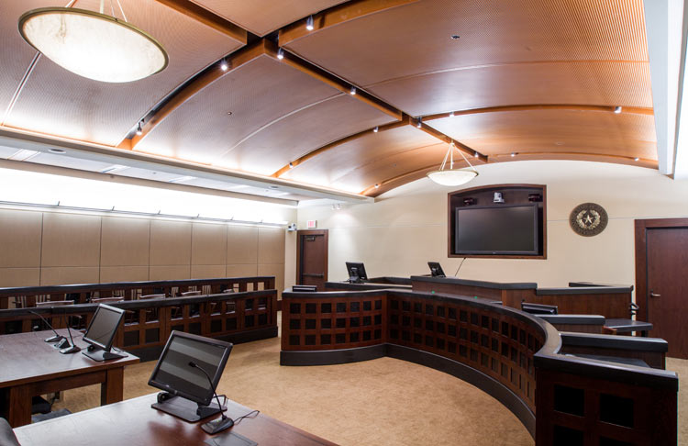
What Happens at a Court Setting?

Slide 22
1) Find Courtroom and make sure your client is there.
  Check in with Deputy/Coordinator if you missed docket call
2) The State’s File is in a Cardboard Box on the table or the jury box.
  Pull your file and look at it – don’t need to ask permission, just dig in. Open file policies are nice ☺
3) Hand it to the prosecutors and have them review it.
  Practice Tip - While they are reading, you have approximately 30-60 seconds to make your pitch.
  Practice Tip Bonus! – If this isn’t a trial setting, they haven’t seen your case
4) Prosecutor writes offer on file, with date and initial.
  In any case with a human victim, cannot make offer without contacting a victim. In a FV case, just set it for trial.
  Practice Tip – If the offer says “today only” or “expires before next setting, usually a bluff.

Slide 23
5) Confer with client
  “Never trust NO-BOD-Y”
  Don’t EVER repeat your client’s side of the story as if you were there.
6) Speak with Coordinator to reset the case
  Pre-trial reset – 30 days to file motions, give Prosecution time to upload discovery, speak with victim, etc.
  Trial Setting – 45-90 days
    Practice Tip – sometimes, the only way you can get a Prosecutor to actually look at your case is to set it for trial.
7) Sign reset form, have client sign form, return form to coordinator.

Slide 24
e-discovery
Sign up through http://home.bexar.org/da/
  Download police report, videos, lab reports, etc
Also use this system to get more info or to sign up your client for Pre Trial Diversion
Generally, review discovery before arriving in court
First thing when you get to Court is check the State’s File for
  Charging Instrument
    NOT included on e-discovery
  Info NOT uploaded to e-discovery

Slide 25
Obstruction of a Highway
  Charged with DWI
  No prior DWI or Obstruction arrests
  BAC less then .15 (or Unknown – waiting on blood)
  No accident
  Not an asshole
Deferred Adjudication available
  Practice tip – Deferred is ILLEGAL on a DWI generally.
12 months probation
  Ignition Interlock Required for half. Fine, court costs, DWI ED, Community Service, etc.

Slide 26
Pre-Trial Diversion
To Qualify
  No prior criminal history
  ANY age
  Most misdemeanors… except
    DWI
    Family Violence
    Animal Cruelty
    Sex stuff…
Results in a DISMISSAL of charges
Sign up through e-discovery
TIME LIMITATION – MUST APPLY 60-90 days from date of arrest.
Cost – non-refundable $50 application fee… even from appointed clients

Slide 27
Trial Announcement aka “The Not Ready Game”
When announcing at DOCKET CALL, always announce “conferring”
Confer.
PROSECUTION ANNOUNCES FIRST!
  If prosecutor announces “Ready”, you may announce “Ready” or “Not Ready”
  1st motion for continuance will be granted for either side
  Practice Tip
    Only Garrahan (CC4) requires a written motion for continuance - can be written on notebook paper AFTER you announce.

Slide 28
The Not Ready Game, Part 2
If the Prosecutor Announces Not Ready for a 2nd time, they generally dismiss the case.
  Based out of Confrontation Clause and Speedy Trial
Rarely is this a hearing or a fight. Generally, most prosecutors will have a dismissal they hand to the Judge at announcement
Practice Tip – Prosecutors Lie.

Slide 29
Oh Crap.
Prior to accepting any sort of plea, make SURE that you have discussed with your client any collateral consequences.
  http://www.abacollateralconsequences.org/search/?jurisdiction=45
DWI (DL, Surcharges, mandatory jail, etc)
POM (Automatic Driver’s License Suspension)
Any State of Texas Licensing – Nurse, Doctor, Lawyer, etc.
IMMIGRATION!!!

Slide 30
Plea Paperwork
Court’s Admonishments
Certification of Right to Appeal
Application for Probation/Deferred
Personal Data Sheet
Discovery Agreement
VOUCHER!!!!
  Don’t forget appointment order

Slide 31
Vouchers
Fill it out COMPLETELY
  Ask to borrow prosecutor or court file to get SID or other necessary information
  Attach Appointment Order
    E-mail or fax is fine, or get Judge to sign an order after the plea.
Have the Judge sign it
Take it to the clerk and have Clerk sign it and time stamp it
Ask to make 2 copies
Return Original, a copy and APPOINTMENT ORDER to the clerk
Keep a copy for your records

Slide 32
Vouchers
Auditor’s office has 30 days to pay
Paymode-X is available for direct deposit
Practice Tip
  Every 6 months, go back and make sure you’ve gotten paid for every case you’ve submitted a voucher.
  Estimated 75% of Attorneys are not getting paid every time due to not following up, returned vouchers, etc.
Auditor’s Office returns flawed vouchers to the clerks.
  Incomplete vouchers can get “misplaced”, especially when you are a jerk who didn’t keep a copy

Slide 33
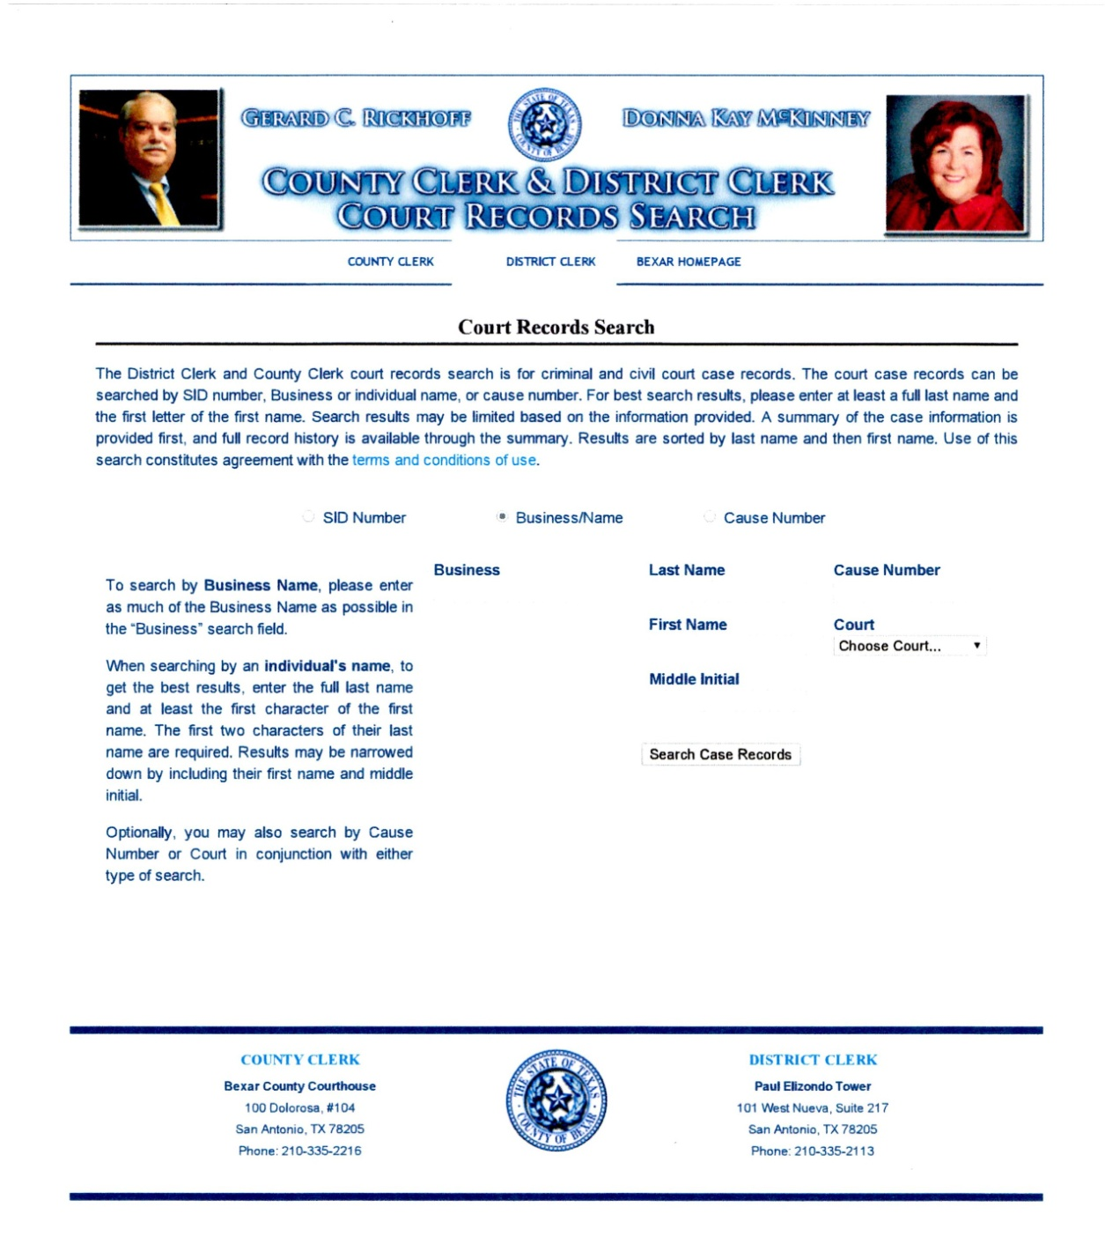
http://apps.bexar.org/search/search.html

Slide 34
Traffic Tickets
DPS – Outstanding Tickets
  http://www.texasfailuretoappear.com/search.php
San Antonio Municipal Court Ticket Search
  https://www.municipalrecordsearch.com/sanantoniotx
DPS Criminal History Search
  https://records.txdps.state.tx.us/DpsWebsite/Login.aspx

Slide 35
Traffic Tickets
San Antonio Municipal Court
  Attorney Conferring Thursday afternoon & Friday
Generally Prosecutors will offer Deferred Adjudication, and may TIC multiple charges.
Will NOT TIC insurance…
  Practice Tip – Bring proof of current insurance, inspection, registration, tail light, etc.
Judges will lower the fine amount

Slide 36
San Antonio Municipal Court
$4 parking
Go to the Clerks
  Ask for directions
  Fill out case number and your bar number, etc
  They give you a printout
  Take this printout to (a) Judge or (b) a prosecutor

Slide 37
San Antonio Municipal Court
Prosecutors
Do NOT discuss the facts of the case
Can plea bargain for deferred adjudication
Judges
Do NOT discuss the facts of the case
Cannot dismiss cases
Will lower fine
Not necessary if you have ONE ticket
Always Necessary
If you have 2+ tickets, can dismiss one for a plea on the other (TIC)
Can plea bargain for deferred adjudication
Can lower fine

Slide 38
JUSTICES OF THE PEACE
Precinct 1
Judge Robert Tejeda and Judge Ciro Rodriguez
3505 Pleasanton Rd.
San Antonio, Texas 78221
(210) 335-4500
Precinct 2
Judge Roberto A. Vazquez and Judge Monica Lisa Caballero
7723 Guilbeau Rd Suite 105
San Antonio, Texas 78250-3216
(210) 335-4800
Precinct 3
Judge William Donovan and Judge Jeff Wentworth
8918 Tesoro Drive, Suite 300 (3rd FLOOR!!!)
San Antonio, Texas 78217
(210) 335-4700
Precinct 4
Judge Rogelio Lopez and Judge Yolanda Uresti
2711 S.E. Loop 410 South
San Antonio, Texas 78222
(210) 335-4900
JP4@Bexar.org

Slide 39
JP Conferring
Submit a letter of Representation by Fax
  Will Remove the Warrant
Appear on Attorney Conferring Day
You can also appeal to the County Court at Law by submitting an attorney bond

Slide 40
Practice Tip
If a client has a Commercial Drivers License, client is NOT ELIGIBLE FOR DEFERRED
  State Law
SO WHAT DO I DO?!?!?
  Appeal to County Court
    File an attorney appeal bond

Slide 41
DWI “Operate”
Sec. 49.04. DRIVING WHILE INTOXICATED. (a) A person commits an offense if the person is intoxicated while operating a motor vehicle in a public place.
"Intoxicated" means:
  not having the normal use of mental or physical faculties by reason of the introduction of alcohol… a drug, a dangerous drug, a combination … into the body; or
  having an alcohol concentration of 0.08 or more.

Slide 42
Operation of a Motor Vehicle
…this Court (CCA) has concluded that a person "operates" a vehicle when "the totality of the circumstances demonstrate that the defendant took action to affect the functioning of his vehicle in a manner that [651] would enable the vehicle's use."
Kirsch v. State, 357 S.W.3d 645, 650-51 (Tex. Crim. App. 2012)

Slide 43
More Examples of “Operate”
Many Texas juries have rendered guilty verdicts even when the evidence showed that the operator did not successfully make the vehicle "go.“
  Defendant unable to accelerate because vehicle required time to "warm up”
    See, e.g., Denton, 911 S.W.2d at 388
  Defendant asleep in driver's seat of idling vehicle parked in parking lot
    Dornbusch v. State, 262 S.W.3d 432 (Tex. App.—Fort Worth 2008, no pet.)
  sitting on top of his motorcycle attempting to "kick-start" it, which appellant ceased when Deputy Johnson approached him.
  Kirsch v. State, 357 S.W.3d 645, 650 (Tex. Crim. App. 2012)

Slide 44
Use of a Hand Held Communication Device
A person commits an offense if the person uses a hand-held mobile communication device to 1) engage in a call, 2) send, 3) read or write a text message, 4) view pictures or written text whether transmitted by internet or other electronic means, 5) engage in gaming, or 6) engage in any other use of the device while operating a moving motor vehicle.

Slide 45
Questions?
Andrew Froelich
(210) 725-4658 – cell
andrewfroelich@gmail.com
Andrewfroelich.com
Helpigotarrested.com
Or check out sayla.org/attorneyresources to download this PowerPoint, and some other helpful forms I uploaded

